Slide 1

CORE JAVA PROGRAMMING COURSE

Slide 2
INTRODUCTION
What is Java?
Java is an object oriented programming language. It is high level , robust and a secure programming language.
3 Platforms:
J2SE
J2EE
J2ME

Slide 3

History Of Java:
Java was developed by James Gosling at Sun Microsystems in 1991. It was named and fully released in 1995.
Teams Members with James Gosling at Sun Microsystems are Mike Sheridan and Patrick Naguton.

Slide 4
Key Features:
Object Oriented
Platform Independent
High level language
Architecture Neutral
Multithreaded
Secured
Robust
Safe

Slide 5
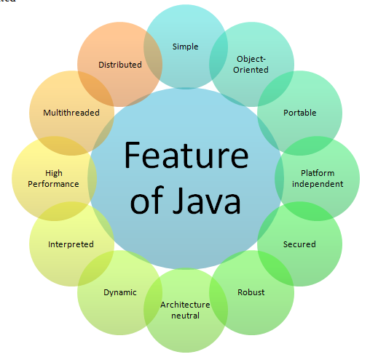
Java Features:

Slide 6
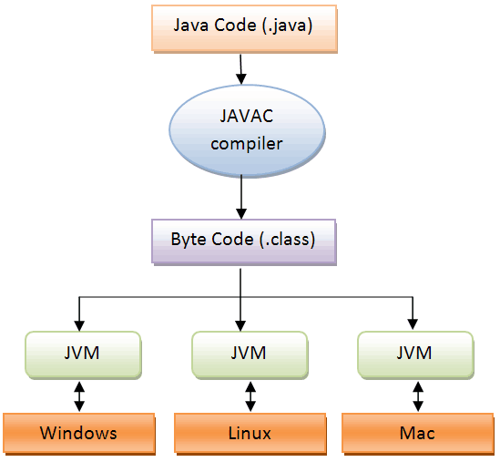
Java platform independence:

Slide 7
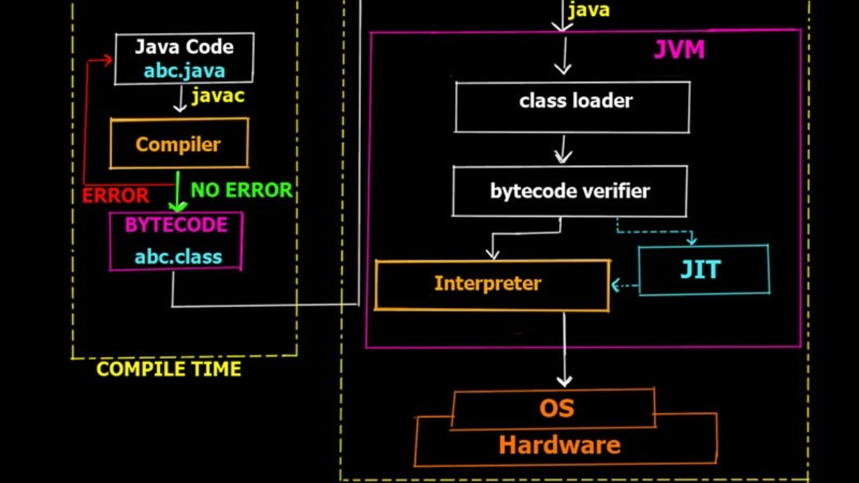

COMPILATION PROCESS

Slide 8
JVM - Java Virtual Machine
JVM is an abstract machine.
It is called a virtual machine because it doesn't physically exist.
It is a specification that provides a runtime environment in which Java byte code can be executed.
It can also run those programs which are written in other languages and compiled to Java byte code.

Slide 9

JRE – Java Runtime Environment.
The Java Runtime Environment is a set of software tools which are used for developing Java applications.
It is used to provide the runtime environment.
It is the implementation of JVM. It physically exists.
It contains a set of libraries + other files that JVM uses at runtime.

Slide 10
JDK – Java Development Kit.
The Java Development Kit is a software development environment which is used to develop Java applications and applets.
It physically exists.
It contains JRE + development tools.

Slide 11
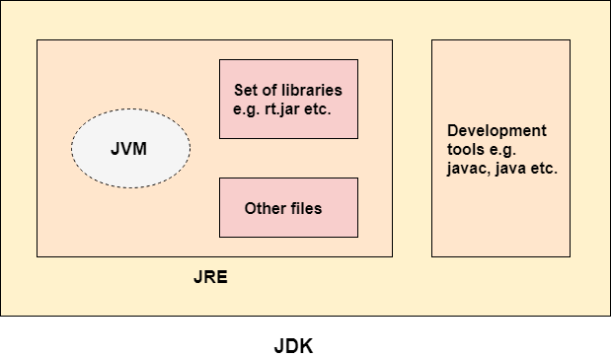

Slide 12
Simple Java program:
Java code file name: FirstJavaProgram.java
public class FirstJavaProgram
{
public static void main(String args[])
{
System.out.println(“This is our first java program…”);
System.out.println(“Hello world..”);
}
}

Slide 13
Java Variables:
A variable is a container which holds the value while the java program is executed.
It is a name of memory location.
There are three types of variables in java:
local variable
instance variable
static variable

Slide 14
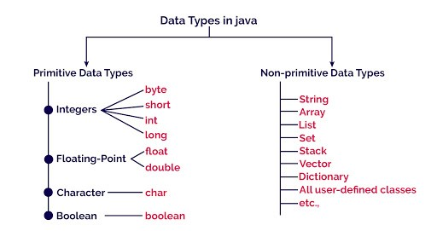
Java data types

Slide 15
Java Data Types:
Data types specify the different sizes and values that can be stored in the variable. There are two types of data types in Java:
Primitive data types:
Non-primitive data types

Slide 16
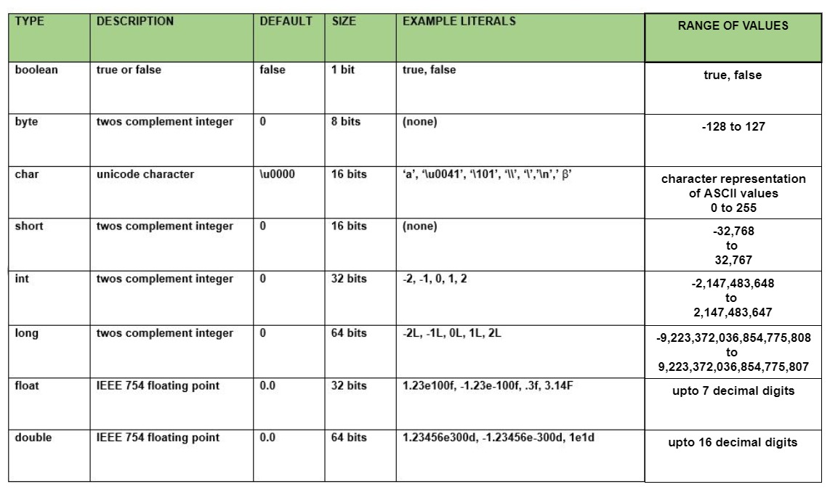
Primitive data types:

Slide 17
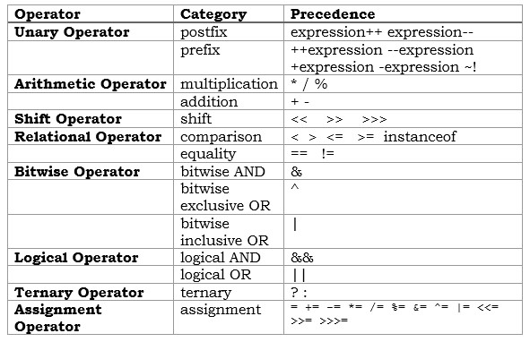
Java Operators:
Operators in java is a symbol that is used to perform operations.

Slide 18
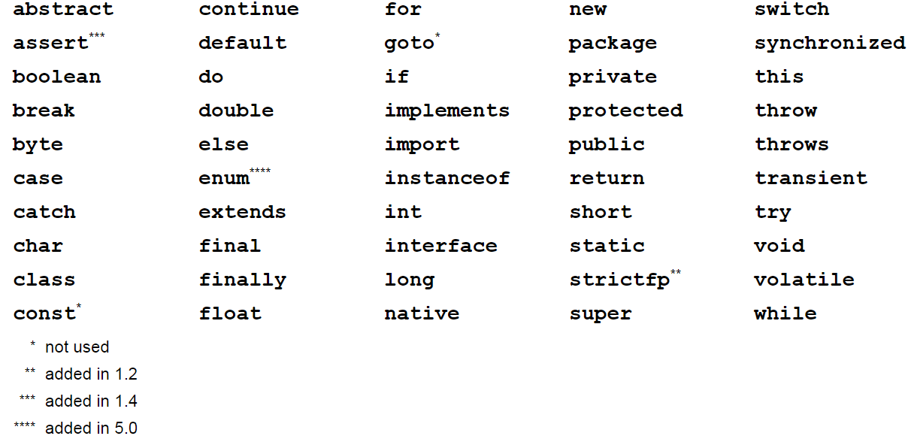
Java Keywords:

Slide 19
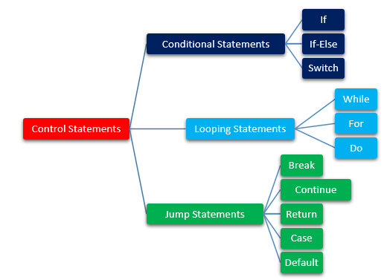
Statements:

Slide 20
Condition statement concept:
1. Find the given year is leap year or not
2. Find the given character is vowel or not
3. Simple banking concept using nested if.else
4. Switch concept

Slide 21
Control statement concept:
Find the given number is Amstrong number or not
Any concept in do.while
Find the prime numbers between the range

Slide 22
Java array
It is an object which contains elements of a similar data type.
Advantages:
1.Code optimization
2.Random access
Disadvantages:
1.Array Size.
Two types of Array:
1.Single Dimensional Array
2.Multi Dimensional Array

Slide 23
Access Modifiers | Within class | Within package | Outside package by subclass only | Outside package
Private | yes | no | no | No
Default | yes | yes | no | No
Protected | yes | yes | yes | No
Public | yes | yes | yes | yes

Slide 24
Java Method:
A Java method(function) is a collection of statements that are grouped together to perform an operation.
Syntax:
function_returntype function_name(arguments)
{
//function statements
}

Slide 25
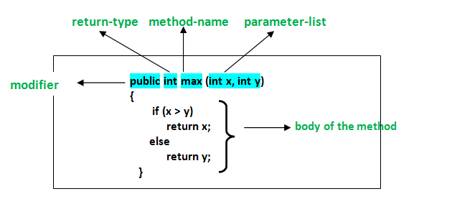
Function simple example:

Slide 26
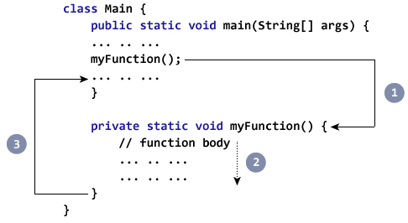
Function working process

Slide 27

Constructor:
It is used to initialize the object.
Rules for creating Java constructor:
1.Constructor name must be the same as its class name
2.A Constructor must have no explicit return type
3.A Java constructor cannot be abstract, static, final, and synchronized

Slide 28
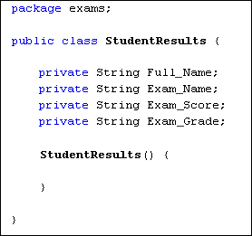
Constructor Example:

Slide 29
There are two types of constructor
1.Default constructor / no-argument constructor:
A constructor is called "Default Constructor" when it doesn't have any parameter.
2.Parameterized constructor:
A constructor which has a specific number of parameters is called a parameterized constructor.

Slide 30
Features of Constructor:
1.No need of initialization for constructor function calling.
2.No need of object creation for normal function calling.
3.Dynamic function creation or calling.
Constructor Overloading:
Constructor overloading in Java is a technique of having more than one constructor with different parameter lists.

Slide 31
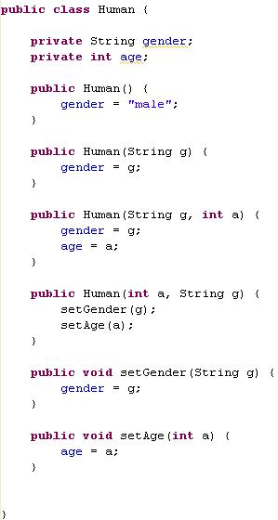
Constructor Overloading example:

Slide 32
GARBAGE COLLECTION
In java, garbage means unreferenced objects.
Garbage Collection is process of reclaiming the runtime unused memory automatically. In other words, it is a way to destroy the unused objects.
To do so, we were using free() function in C language and delete() in C++. But, in java it is performed automatically. So, java provides better memory management.

Slide 33
Java Arrays:
Collection of values(with same data type) to stored in single variable
Syntax:
datatype var_name[] = new datatype[size];
Examples:
int numbers[] = new int[10];
String days[] = new String[7];
char vowels[] = new char[5];

Slide 34
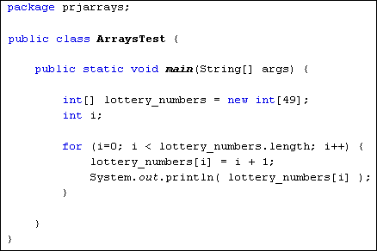
Arrays Example:

